Slide 1
Sign Language Decoder
(Based on hand gesture recognition)

Slide 2
Problem
More than 9billion people in the world suffer from speech and hearing impairment.
Self expression have always been a challenge they face in their day to day life as most of the population don’t understand sign language.
This communication gap can lead to further frustration than what they already have to endure.

Slide 3
Solution
A sign language decoder which has the capability to convert hand signs or hand gestures to text
Makes use of a camera which tracks the hands to decode what they are trying to convey
The decoded message is then displayed on screen
Thus saving a lot time and frustration

Slide 4
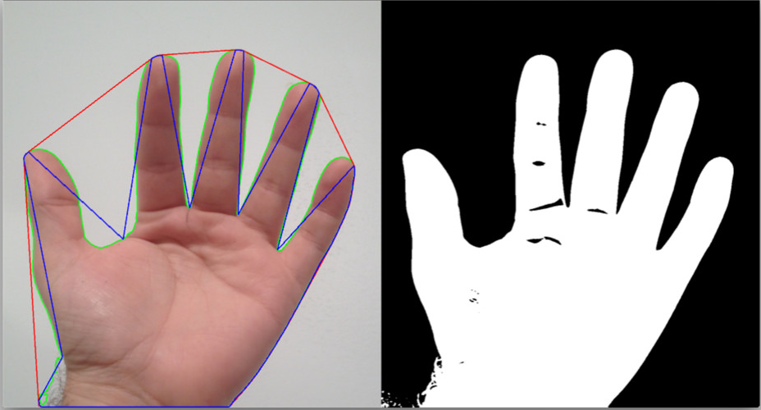
WORKING
Hand Gesture recognition Using Open CV and Python
Captures the video and defines the Region Of Interest (ROI).
In the ROI, the BGR colours are converted to HSV colours
Skin Colour Range is being defined in HSV and anything which comes in this range is taken as ‘ 1’ or ‘BRIGHT ’and the other part is considered ‘ 0 ’or ‘DARK’
The Dark side is blurred in order to reduce the noise in the image and a binary mask of the image is created

Slide 5
A convex hull is created around the hand and then the area of convex hull and the area of hand is calculated by which we could find the area ratio.
By knowing the area ratio, number of defect points due to fingers is calculated . Different gestures have different area ratios thus having different no of defect points.
Some of the defect points are eliminated if they form an angle less than the threshold angle as specified by the programmer.
By knowing the exact number of defect points, corresponding gestures are printed on the screen when they fall in the respective ranges

Slide 6
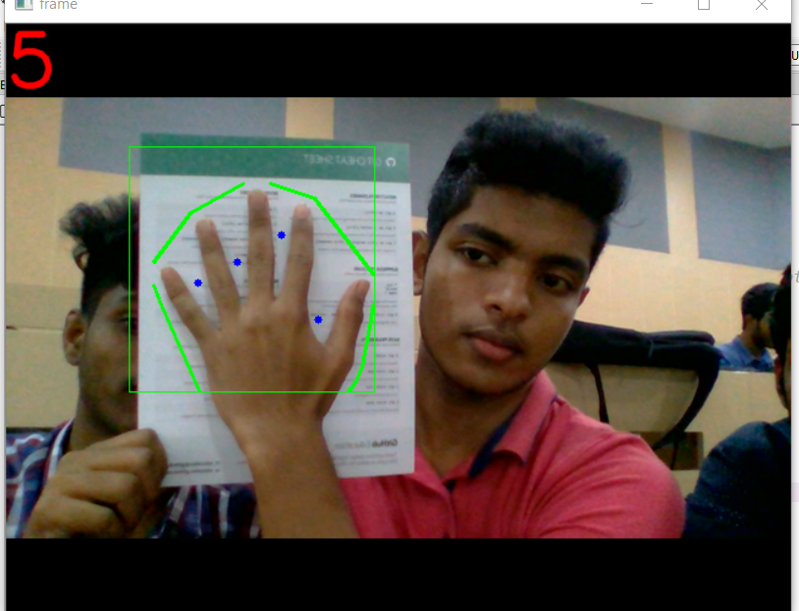
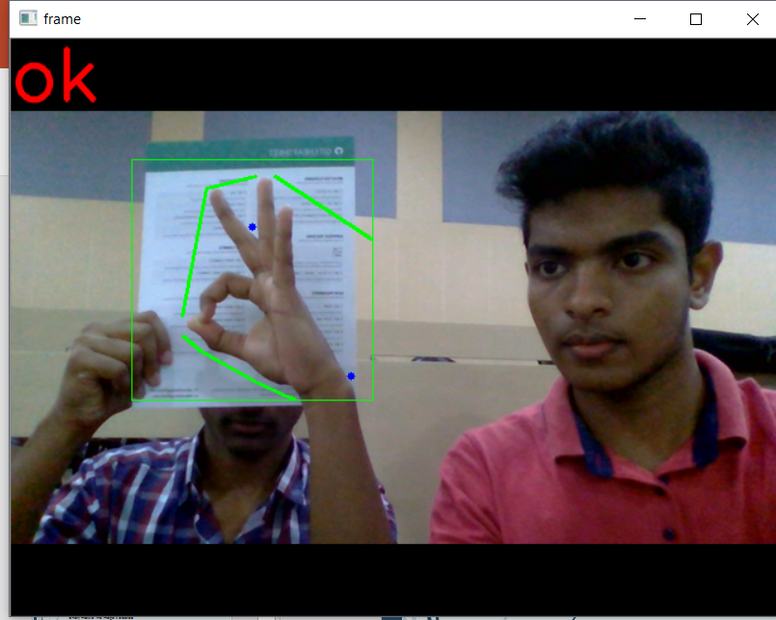

Slide 7
